Slide 1
Video Game Market Analysis (1996–2020) Using Power BI to uncover sales and rating trends in the gaming industry
Final Project for the Data Analytics
Course at CyberPro Israel
Presenters:
Ilia Oleinikov
Svetlana Saveleva

Slide 2
Table of contents
01
02
03
04
05
Research Goal & Question
Data Preparation
Analysis & Key Methods
Visualization & Insights
Conclusions
& Recommendations

Slide 3
01
Research Goal & Question

Slide 4

What type of game should develop today to maximize both critical reception and commercial success?
Key Points: Explore video game market trends (1996–2020) Combine sales data and Metacritic ratings Identify what kind of game would perform best today

Slide 5
02
Data Preparation

Slide 6
Datasets Overview
vgsales.csv:
metacritic.csv:
Global and regional video game sales by platform, genre, publisher, and region
~12,000 unique values
Sources: Kaggle, vgchartz.com
Game ratings based on Metascore
(a weighted average of reviews from top critics, publications and users)
~19,000 unique values
Source: Kaggle, metacritic.com

Slide 7
Data Preparation & Modeling
Data Import
Data Modeling
Data Cleaning & Transformation
Both datasets were imported into Microsoft Power BI as CSV files
Standardizing column names and data types
Removing duplicates and handling missing values
Creating relationships between datasets
Merging on Game Name and unifying genre and platform categories
Combined datasets into a unified model linking sales and metascore data
Added calculated columns and measures (e.g., total global sales, average metascore by genre/year/platform)

Slide 8
03
Analysis & Key Methods

Slide 9
Analysis & Key Methods
2. Top Performers
1. Release Trends (1996–2020)
3. Correlation: Metascore vs. Global Sales
Analyzing yearly release counts by genre and platform revealed:
Shifting genre popularity over decades
Peaks and declines for each genre
Potential opportunities in genres with strong ratings but fewer recent releases
Top 5 Publishers by Global Sales
Top 5 Games by Global Sales
Top 10 Games by Global Sales vs. Metascore
This comparison highlights that the most profitable games are not always the most critically acclaimed, encouraging studios to balance commercial and artistic goals
A key visualization explored the correlation between sales and critical ratings across genres and platforms, helping identify which combinations historically achieved both critical and financial success

Slide 10
04
Visualization & Insights

Slide 11
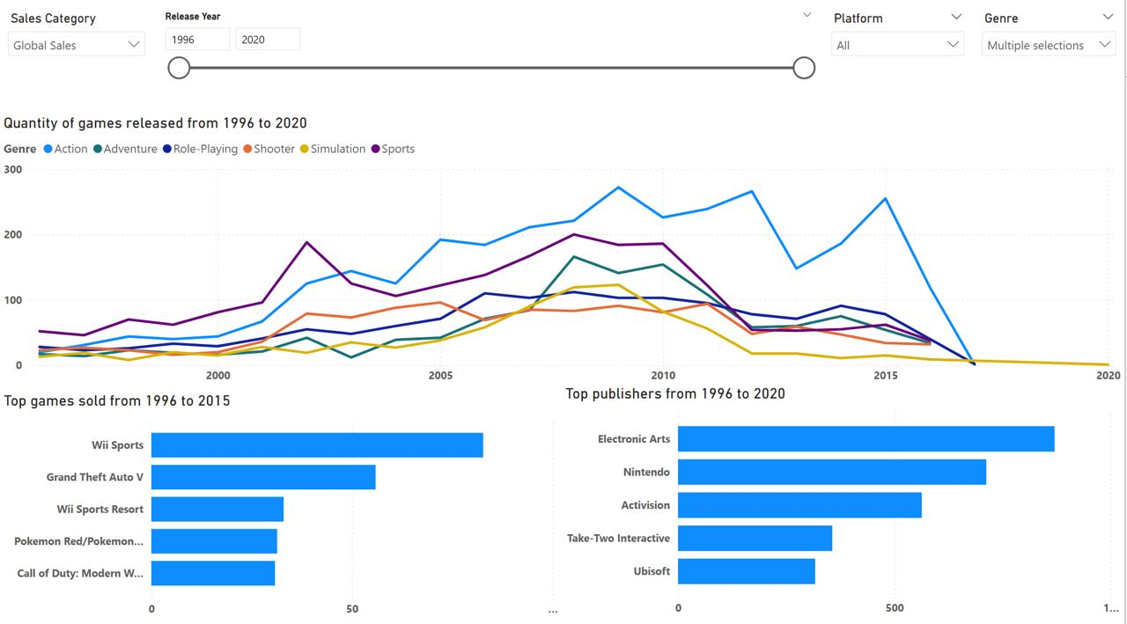
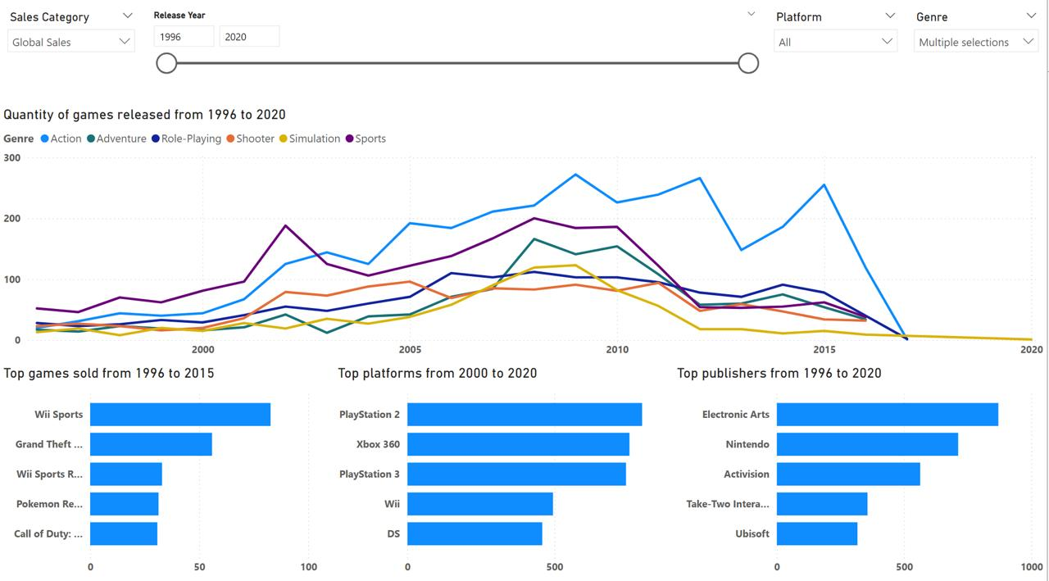
1. Game Release Trends (1996–2020)
Action games dominate in volume
RPG, Sports, and Shooter genres remain steady
Adventure & Simulation peaked around 2010
Revival potential in underrepresented genres

Slide 12
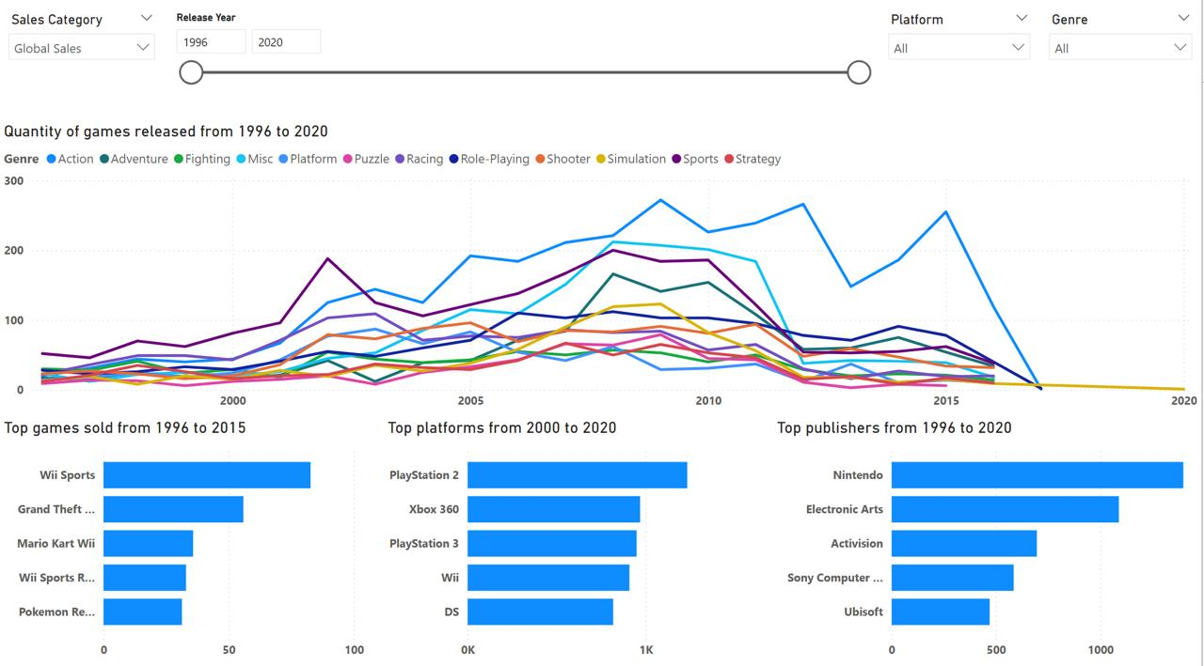
2. Best-Selling Games & Publishers
Top Games: Wii Sports, GTA V, Mario Kart Wii, Pokémon Red/Blue
Top Platforms: Xbox 360 & PlayStation
Top Publishers: Nintendo, EA, Activision
Action/Shooter dominate revenue

Slide 13
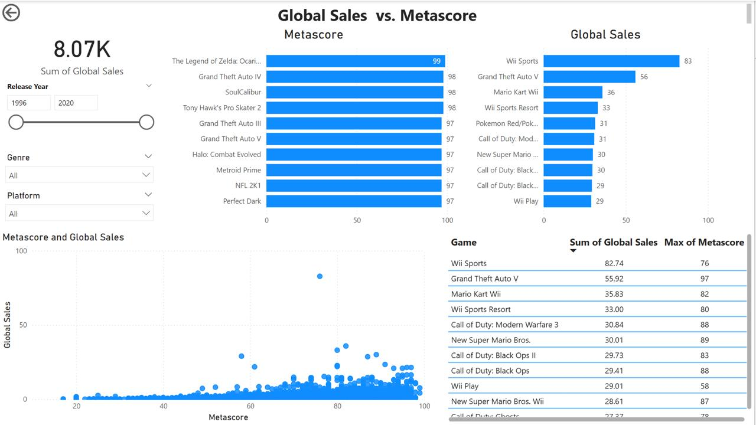
3. Sales vs. Metascore Correlation
Moderate correlation overall
Action–Adventure shows highest balance
GTA V, The Last of Us succeed in both
Portal, BioShock — critically acclaimed, less commercial

Slide 14
05
Conclusions & Recommendations

Slide 15
Conclusions & Recommendations
Action and Adventure genres maintain long-term profitability
Focus on Action–Adventure hybrids with narrative depth and high replay value
Blend shooter mechanics creatively without relying solely on formulaic design
Prioritize multi-platform releases, especially Xbox and PlayStation ecosystems
Revive high-rated but underproduced genres (e.g., Puzzle, Platform) to capture nostalgia-driven audiences
Target both quality and mass appeal: games that appear in both Top Sales and Top Metascore lists (e.g., GTA V) prove that critical and financial success can coexist
Shooter games dominate short-term sales but show lower critical reception
Cross-genre hybrids (Action + Narrative depth) represent the most sustainable development direction

Slide 16






Real data: Our prediction was right!

Slide 17


Thank you for your attention!

